Slide 1


AI in Action
Tools You Can
Use Tomorrow
Richard Reaume and James Desjardins
Shared introduction, then your choice of breakout
Notes:
0:00–1:00 / Together. Richard and James welcome participants. Frame the full hour: shared examples first, then two simultaneous 30-minute breakouts. Each participant has a computer. Preserve the supplied OCTE/takeTECH styling and the author’s current screenshots. Cover image is a generated concept illustration.

Slide 2
Our hour together
First 30 minutes
Next 30 minutes
Together
Choose your group
Tools we use
Real examples
What makes a result useful
Work with James or Richard
Try a task on your computer
Check and improve the result
Notes:
1:00–2:00 / Together. Stay in one group for the first half. Explain that both presenters build on the same workflow: task, context, result, check. Announce the physical group locations when known; do not send anyone to projects yet.

Slide 3
Tools we will use and explore
Google
Microsoft
Personal assistants
Gemini + Gems
Gemini Notebook
AI Studio / Antigravity
Copilot chat
Copilot agents
ChatGPT Work / dots
Grok Bot
Meta Muse
Notes:
2:00–4:00 / Together. James introduces Google and Microsoft; Richard connects them to personal assistants. Keep this tool map concise so the shared introduction includes actual demonstrations.
Gems: https://support.google.com/gemini/answer/15236405?hl=en
Copilot: https://support.microsoft.com/en-us/microsoft-365-copilot/build-your-own-agent-with-microsoft-365-copilot
Gemini Notebook studio: https://support.google.com/gemininotebook/answer/16206563?hl=en
Audio Overviews: https://support.google.com/gemininotebook/answer/16212820?hl=en
AI Studio Build: https://ai.google.dev/gemini-api/docs/aistudio-build-mode
AI Studio access: https://ai.google.dev/gemini-api/docs/available-regions
Google Antigravity browser: https://antigravity.google/docs/ide/browser
ChatGPT Work: https://learn.chatgpt.com/docs/use-chatgpt
OpenAI dots: https://learn.chatgpt.com/docs/dots
Grok Bot: https://docs.x.ai/grok-bot/overview
Meta Muse: https://about.fb.com/news/2026/09/introducing-muse-personal-ai-agent/
Pendulum reference: https://openstax.org/books/college-physics-2e/pages/16-4-the-simple-pendulum

Slide 4

The goal: one useful result tomorrow
1
2
3
4
Your task
Your sources
A real artifact
Your check
A lesson, a visual, an app or a finished resource pack
Notes:
4:00–5:00 / Together. Use task, sources, artifact and check to frame the examples. James demonstrates useful instructions; Richard adds source media, a real app and a finished file. Ask participants to think of an output they could use tomorrow.

Slide 5
Everyday chat in practice
JAMES / LIVE DEMO
Give it a real task.
Add useful context.
Ask for one revision.
What would you improve in the first answer?
Notes:
5:00–9:00 / James leads. Keep this editable holding slide while demonstrating a real classroom task in Gemini or Copilot. Compare the first answer with one revision. Richard asks which directions would be worth saving.

Slide 6
Gemini Gems
JAMES / LIVE DEMO
Save useful instructions.
Try a fresh request.
Refine what you reuse.
Which instructions would you like to stop repeating?
Notes:
9:00–12:00 / James leads. Show his chosen Gem and reusable instructions, then try a fresh request and review the result. Richard connects this to useful context. Rehearse the actual account. Source: https://support.google.com/gemini/answer/15236405?hl=en

Slide 7
Copilot chat and agents
JAMES / LIVE DEMO
Choose the job.
Name the sources.
Test the response.
What would you want this workflow to produce?
Notes:
12:00–14:00 / James leads. Optional Copilot chat or agent slot; use an agent only if available in his account. If skipped, use these two minutes for another chat/Gem revision. Handoff: We have seen useful instructions. Richard will now add source material and tools, then show what they produce. Source: https://support.microsoft.com/en-us/microsoft-365-copilot/build-your-own-agent-with-microsoft-365-copilot

Slide 8
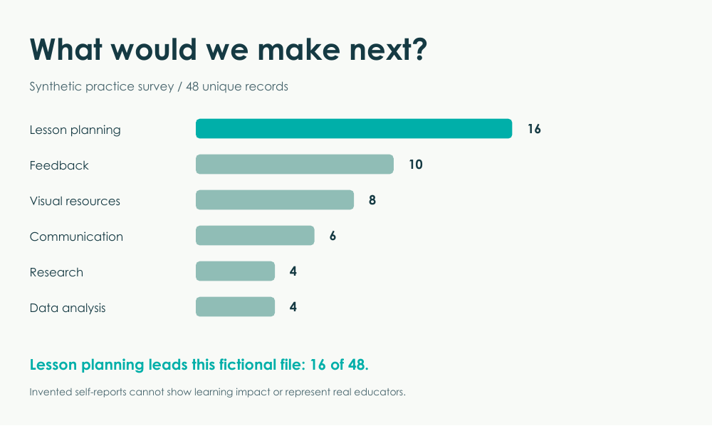
NotebookLM: PDFs into media
RICHARD / LIVE DEMO
Source: verified survey facts
Ask a cited question.
Show the infographic.
Play a short audio excerpt.
Lesson planning: 16 of 48
Synthetic practice data
Ready workshop example
Notes:
14:00–18:00 / Richard leads. Leave this slide up, then switch to the prepared notebook. Show the actual NotebookLM infographic and play a prepared 20–30 second audio excerpt; generate and check these before Monday. Ask one cited question live. The slide image is an authored workshop example, not a NotebookLM account screenshot. James asks which format would help a learner.
1. NOTEBOOKLM / PDFs into media
Source: https://ai-in-action.stemed.ca/starter_files/Verified_Survey_Facts.pdf
Ready infographic: https://ai-in-action.stemed.ca/examples/Survey_Infographic.pdf
Before Monday: Create a notebook and add Verified_Survey_Facts.pdf. Generate an infographic and an Audio Overview, then check them. Keep the finished outputs open and download the audio where the account allows it. Do not spend the live slot waiting for both outputs to generate.
Live question:
Using only this source, what did the 48 unique fictional responses ask AI to help with next? List each task and its count, then cite the source. Explain why these data cannot support a claim about real Ontario educators.
Infographic customization:
Create a clear, playful infographic for educators titled “What would we make next?” Show the six next-task categories and their exact counts. State that this is synthetic practice data with 48 unique responses, after removing two exact duplicates from 50 raw rows. Do not imply representative findings or measured time savings. Make the most requested task easy to spot.
Audio customization:
Explain the six next-task categories in a short, friendly conversation for educators. Use only the supplied source. Open with the most requested task, explain one practical implication as a suggestion, and end with the synthetic-data limitation. Avoid claiming that this fictional survey represents real teachers.
On screen: Ask the question, open one citation, show the prepared infographic, and play 20–30 seconds of the prepared audio. Check lesson planning = 16 of 48 and all six counts sum to 48. Ask James which representation he would use with learners.
If slow: Show the prepared NotebookLM result. If unavailable, show the workshop infographic and identify it as the authored example. It is not a substitute recording of the audio.
Google documentation: https://support.google.com/gemininotebook/answer/16206563?hl=en

Slide 9
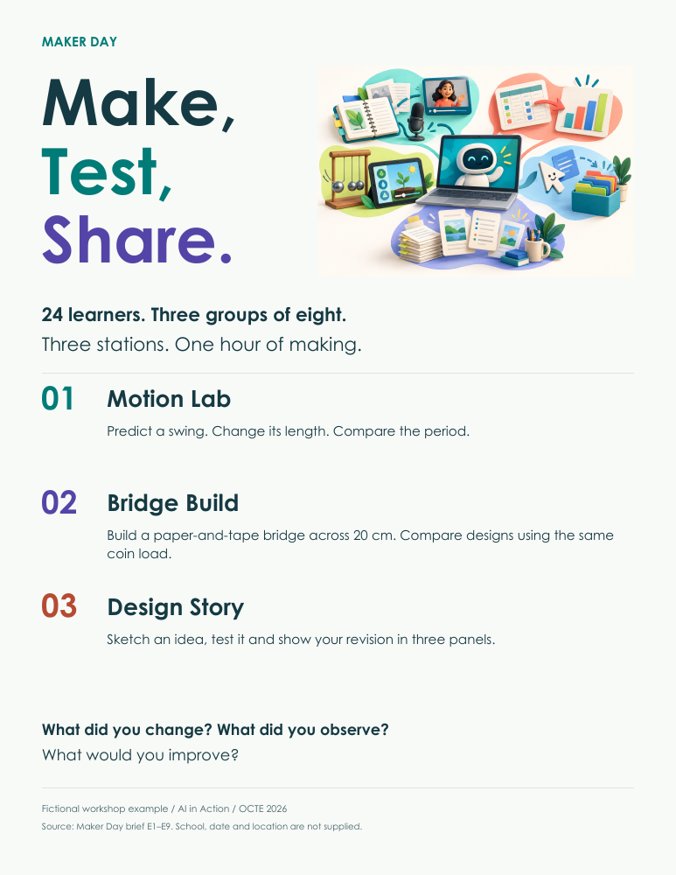
ChatGPT Work: a Maker Day poster
RICHARD / LIVE DEMO
Work preferred / dots alternative
“Make me a playful,
one-page launch poster.
Deliver the PDF.”
Open it. Check a source fact.
Ask for a visual revision.
Ready workshop example
Notes:
22:00–26:00 / Richard leads. Work is the preferred live route; dots is the alternative if rehearsed and available. Source: Maker Day brief. Deliverable: one-page launch poster PDF. Open the real result, check a source fact, ask for one visual revision. Pre-open a completed run so a slow new task can continue while Richard shows its result. The supplied poster is an authored backup, not a Work account output.
3. CHATGPT WORK / A Maker Day poster people can open
Preferred: Work on this computer or https://chatgpt.com/ with Work selected.
Alternative: Give the same source and task to an available dot. Rehearse its file delivery before the session; connected local-computer access is separate from its cloud computer.
Source: https://ai-in-action.stemed.ca/starter_files/Maker_Day_Source_Brief.pdf
Ready poster: https://ai-in-action.stemed.ca/examples/Maker_Day_Launch_Poster.pdf
Starting prompt (attach Maker_Day_Source_Brief.pdf):
Create a finished, downloadable, one-page PDF launch poster for this fictional Maker Day. Title it “Make, Test, Share”. Aim it at secondary learners. Make it playful, clean and readable from across a classroom, with a strong visual and lots of breathing room. Include 24 learners, three groups of eight, three stations and the 60-minute duration. Describe Motion Lab, Bridge Build and Design Story in one short sentence each. Preserve the 20 cm bridge span and the source’s activity details. Do not invent a date, school or location. Add a discreet “Fictional workshop example” footer. Open the PDF preview and give me the download. Check these facts against the source before delivering it. Make the actual PDF file, rather than only giving me poster text.
Live revision:
Keep all facts and the one-page PDF format. Make the headline more playful and give the three station names more visual emphasis. Deliver the revised PDF and tell me what changed.
On screen: Submit the prompt, show how the task creates a file, open the completed PDF, compare one source fact and request the revision. Keep a completed run open in another tab. If generation takes longer than 45 seconds, show that run while the current task continues. If no account-generated result is available, identify the supplied poster as the authored workshop example.
Check: 24 learners; 3 groups of 8; 3 named stations; 60 minutes; 20 cm span; no invented event logistics.
Local option: Give Work the source file’s full path and a dedicated demo output folder. Online option: attach the source PDF and download its result. Both routes use the same task; no app connection is necessary for this file-based demo.
OpenAI documentation: https://learn.chatgpt.com/docs/web
Files: https://learn.chatgpt.com/docs/artifacts-viewer
Dots: https://learn.chatgpt.com/docs/dots/computers-and-apps

Slide 10


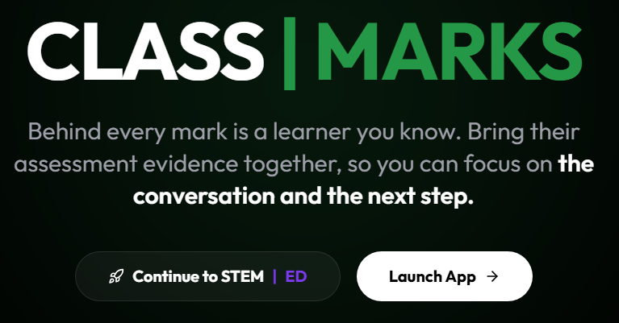
: an app ecosystem built with AI
RICHARD / LIVE DEMO
One real app:
A teacher problem.
One working app flow.
A result I can use.
stemed.ca
Notes:
18:00–22:00 / Richard leads. One app: WORK | SHOP. Show a real workflow and its completed screen or resource. Tell one accurate building story and one correction AI helped make. James connects this to clearer instructions. Use Richard’s actual prepared app; do not imply an untested action succeeded.
2. STEM | ED / One real app: WORK | SHOP
Open: https://stemed.ca/ and select WORK | SHOP, or use Richard’s bookmarked app and prepared workshop.
Before Monday: Pre-open one actual WORK | SHOP workshop Richard can show. Choose one participant-facing workflow that already works. Prepare the starting screen and its completed result; use a fictional or demonstration workshop when appropriate.
On screen: Name the teacher problem the workshop solves. Show one action in the real app and the resulting screen or resource. Explain one specific change Richard asked AI to make while building it and the check he used. James connects this to clearer instructions and reusable context. Keep the demonstration to this one application; the full STEM | ED gallery is an optional reference on slide 20.
Closing question: “What small tool would make one repeated job easier for you?”
If the app cannot load: Use the preserved real STEM | ED screenshot on slide 20 and tell the building story. Do not describe a live action as completed if it did not run.

Slide 11

The workspace around the model matters
Context
Tools
Visible
actions
Reviewed
result
Judge the whole workflow, including the model.
Notes:
26:00–28:00 / Together. Connect James’s saved instructions to Richard’s source-grounded media, real app and exported PDF. Explain the harness as the workspace around the model: context, tools, actions and a result you can inspect. Richard’s perspective is that this surrounding workflow matters increasingly as models converge; model quality still matters.
Gemini Notebook studio: https://support.google.com/gemininotebook/answer/16206563?hl=en
Audio Overviews: https://support.google.com/gemininotebook/answer/16212820?hl=en
AI Studio Build: https://ai.google.dev/gemini-api/docs/aistudio-build-mode
AI Studio access: https://ai.google.dev/gemini-api/docs/available-regions
Google Antigravity browser: https://antigravity.google/docs/ide/browser
ChatGPT Work: https://learn.chatgpt.com/docs/use-chatgpt
OpenAI dots: https://learn.chatgpt.com/docs/dots
Grok Bot: https://docs.x.ai/grok-bot/overview
Meta Muse: https://about.fb.com/news/2026/09/introducing-muse-personal-ai-agent/
STEM ED: https://stemed.ca
Pendulum reference: https://openstax.org/books/college-physics-2e/pages/16-4-the-simple-pendulum

Slide 12
A result worth keeping survives a check
Open the source or the finished file
Check a number, unit or exact link
Try a control that could expose an error
Ask for one change and inspect the revision
Notes:
28:00–29:00 / Together. James names a check for a chat response; Richard names a check for a finished file or app. The same standard applies to both breakouts. During Richard’s circulation revisit these checks: an actual file, a number/unit/link, a control and a real revision.

Slide 13

Now choose your breakout
With James
With Richard
Everyday chat
Gemini Gems
Copilot options
Media, data and apps
Assistants that make files
Choose one of five projects
Two groups. One aim: make something useful.
Notes:
29:00–30:00 / Together. NOW split the group. James supports everyday chat, Gemini Gems and any Copilot option he chooses. Richard supports one of five advanced creation projects. Announce actual room/group locations verbally. James takes over his breakout independently; this deck continues with Richard’s group.

Slide 14
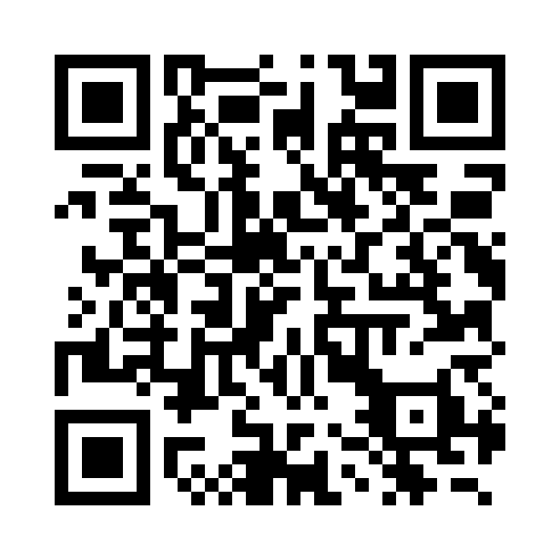
Your project starts here
RICHARD / ADVANCED PROJECTS
Choose one project.
Download its source files.
Use the supplied prompt.
Open a finished example.
ai-in-action.stemed.ca
Scan or type the address
Notes:
Richard breakout 0:00–1:00 (session 30:00–31:00). Open https://ai-in-action.stemed.ca/ on the participant computer; the QR encodes this exact HTTPS address. Scan is optional: type the visible address on the laptop. The companion hub has five project pages, individual source files, copyable prompts and finished examples. Choose one project. No login or ZIP extraction is required for the hub.

Slide 15

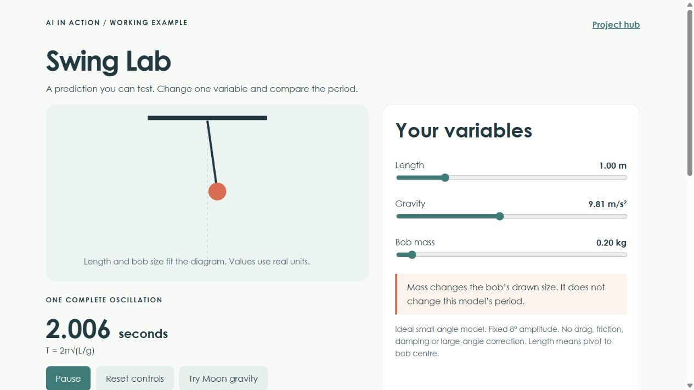
From a prompt to a physics app
Describe the investigation
Use the working preview
Change one requirement
The first win: controls that do something you can test
Notes:
Richard breakout 1:00–4:00. Brief AI Studio app demo before participant work; the three shared demos have already finished. Pre-open Build and prompt 03. Show the preview and change one requirement. If generation stalls for 45 seconds, open the authored Swing Lab fallback and name it as such: https://ai-in-action.stemed.ca/examples/swing_lab.html . Source: https://ai.google.dev/gemini-api/docs/aistudio-build-mode

Slide 16

A beautiful app still needs a physics check
1 m
4 m
New mass
2.006 s
4.012 s
Same period
g = 9.81 m/s² T = 2π√(L/g)
Notes:
Richard breakout 4:00–5:00. Predict before changing length. At g=9.81 m/s², L=1 m gives 2.006 s; L=4 m gives 4.012 s. Bob mass should not change period. The small-angle model omits friction, drag and large-angle correction. Show how one check can expose a believable error. Source: https://openstax.org/books/college-physics-2e/pages/16-4-the-simple-pendulum

Slide 17

Five projects. Choose one.
01
Sources into media
sources
02
Survey into a visual story
data
03
Build a physics app
build
04
Delegate the teaching pack
delegate
05
Website to finished assets
produce
Notes:
Richard breakout 5:00–7:00. Choose ONE of five projects. Pick an output and a tool the participant can open. Gallery slides 21–25 are optional references. Continue to the work period on slide 18. The companion QR is on slide 14.

Slide 18
Your project work period
08
04
05
min
min
min
Make
Check
Improve
I’ll circulate. Show me what exists and what you want to change.
Notes:
Richard breakout 7:00–24:00. Keep slide 18 up while circulating. 8 minutes make, 4 check, 5 improve = 17 minutes. Ask what exists, what was checked and what changed. Offer a workshop example when account access or generation blocks progress.

Slide 19
One result. One correction.
Show the thing you made
Describe the revision you would use tomorrow
I made ___________________.
I checked __________________.
My next revision is ___________.
Notes:
Richard breakout 24:00–30:00. Keep the author’s combined share/exit layout. First four minutes: partners show a real artifact, a check and a correction; take two brief room examples. Final two minutes: I made / I checked / My next revision. Stop the main sequence here. Slides 20–27 are optional references and backups. Individual downloads: https://ai-in-action.stemed.ca/resources.html

Slide 20

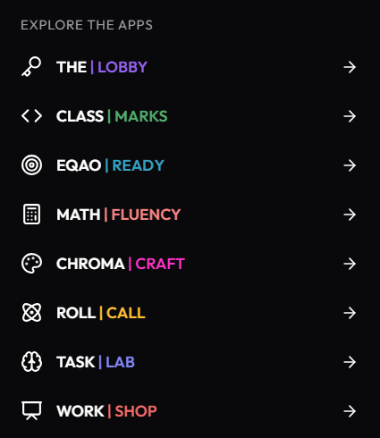
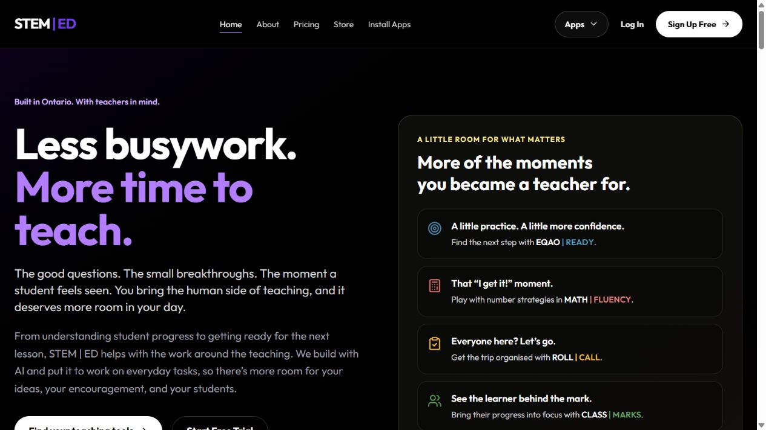
STEM ED: Simple ideas became apps
Notes:
Optional reference after the main session, slide 20. Preserve Richard’s actual STEM ED app menu and website screenshots. The timed live showcase is WORK | SHOP on slide 9. Use this gallery only for a question or if the app cannot load. STEM ED is Richard’s building example, not a participant project. Source: https://stemed.ca/

Slide 21

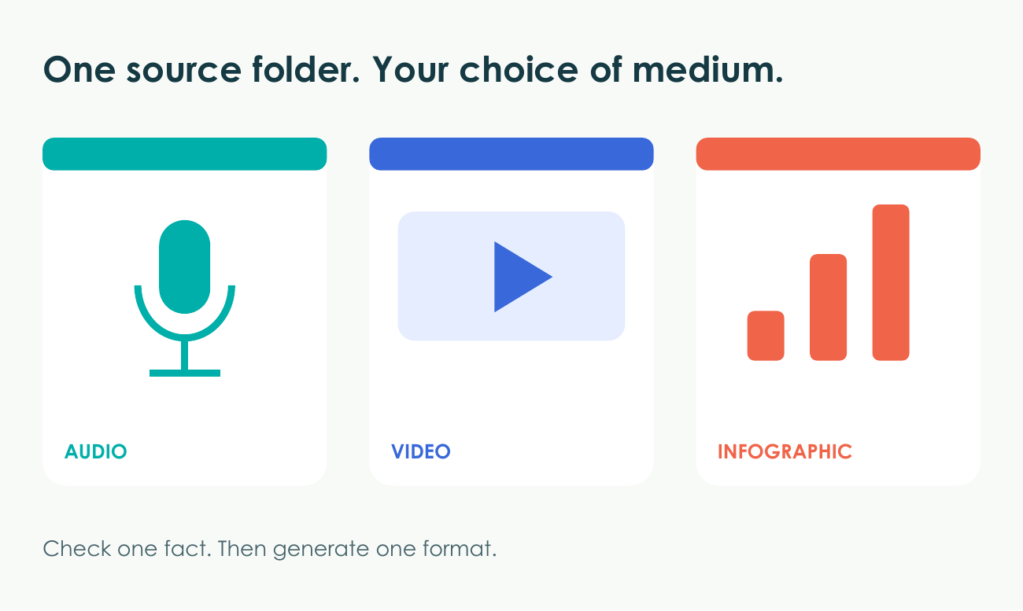
Sources into media
PROJECT 01 / SOURCES
A checked infographic, short podcast-style overview or video overview.
Gemini Notebook / NotebookLM
12–15 min / one first version, one check, one revision
Notes:
Project 01 reference, outside the timed main presentation. Participants choose one project, not all five. Companion guide: https://ai-in-action.stemed.ca/projects/01.html
First win: A checked infographic, short podcast-style overview or video overview.
Check: At 1 m and g=9.81, the ideal period is about 2.006 s. Bob mass does not change it. Fictional observations stay labelled.
Fallback: Use the included storyboard to revise one frame while media generates. A storyboard is the fallback, not a generated podcast.
Preview is an authored workshop example, not a claimed output from the participant’s account.
Gemini Notebook studio: https://support.google.com/gemininotebook/answer/16206563?hl=en
Audio Overviews: https://support.google.com/gemininotebook/answer/16212820?hl=en
AI Studio Build: https://ai.google.dev/gemini-api/docs/aistudio-build-mode
AI Studio access: https://ai.google.dev/gemini-api/docs/available-regions
Google Antigravity browser: https://antigravity.google/docs/ide/browser
ChatGPT Work: https://learn.chatgpt.com/docs/use-chatgpt
OpenAI dots: https://learn.chatgpt.com/docs/dots
Grok Bot: https://docs.x.ai/grok-bot/overview
Meta Muse: https://about.fb.com/news/2026/09/introducing-muse-personal-ai-agent/
STEM ED: https://stemed.ca
Pendulum reference: https://openstax.org/books/college-physics-2e/pages/16-4-the-simple-pendulum

Slide 22

Survey into a visual story
PROJECT 02 / DATA
A landscape infographic plus the fact sheet behind it.
Work, dots, Grok Bot or Muse with file analysis
15–18 min / one first version, one check, one revision
Notes:
Project 02 reference, outside the timed main presentation. Participants choose one project, not all five. Companion guide: https://ai-in-action.stemed.ca/projects/02.html
First win: A landscape infographic plus the fact sheet behind it.
Check: Counts sum to 48. Missing numbers stay missing. Confidence change uses 46 complete pairs. Every chart label matches its fact sheet.
Fallback: Use the provided infographic and ask for a clearer layout. Check the supplied chart instead of waiting for image generation.
Preview is an authored workshop example, not a claimed output from the participant’s account.
Gemini Notebook studio: https://support.google.com/gemininotebook/answer/16206563?hl=en
Audio Overviews: https://support.google.com/gemininotebook/answer/16212820?hl=en
AI Studio Build: https://ai.google.dev/gemini-api/docs/aistudio-build-mode
AI Studio access: https://ai.google.dev/gemini-api/docs/available-regions
Google Antigravity browser: https://antigravity.google/docs/ide/browser
ChatGPT Work: https://learn.chatgpt.com/docs/use-chatgpt
OpenAI dots: https://learn.chatgpt.com/docs/dots
Grok Bot: https://docs.x.ai/grok-bot/overview
Meta Muse: https://about.fb.com/news/2026/09/introducing-muse-personal-ai-agent/
STEM ED: https://stemed.ca
Pendulum reference: https://openstax.org/books/college-physics-2e/pages/16-4-the-simple-pendulum

Slide 23
Build a physics app
PROJECT 03 / BUILD
A working Swing Lab with controls you can test.
Google AI Studio Build; Antigravity or Work as options
15–18 min / one first version, one check, one revision
Notes:
Project 03 reference, outside the timed main presentation. Participants choose one project, not all five. Companion guide: https://ai-in-action.stemed.ca/projects/03.html
First win: A working Swing Lab with controls you can test.
Check: The animation and numeric period agree. Units remain visible. Four times the length gives twice the period. Mass changes size only.
Fallback: Open examples/swing_lab.html. It runs locally. Inspect it, then ask your tool to make one change rather than start from scratch.
Preview is an authored workshop example, not a claimed output from the participant’s account.
Gemini Notebook studio: https://support.google.com/gemininotebook/answer/16206563?hl=en
Audio Overviews: https://support.google.com/gemininotebook/answer/16212820?hl=en
AI Studio Build: https://ai.google.dev/gemini-api/docs/aistudio-build-mode
AI Studio access: https://ai.google.dev/gemini-api/docs/available-regions
Google Antigravity browser: https://antigravity.google/docs/ide/browser
ChatGPT Work: https://learn.chatgpt.com/docs/use-chatgpt
OpenAI dots: https://learn.chatgpt.com/docs/dots
Grok Bot: https://docs.x.ai/grok-bot/overview
Meta Muse: https://about.fb.com/news/2026/09/introducing-muse-personal-ai-agent/
STEM ED: https://stemed.ca
Pendulum reference: https://openstax.org/books/college-physics-2e/pages/16-4-the-simple-pendulum

Slide 24
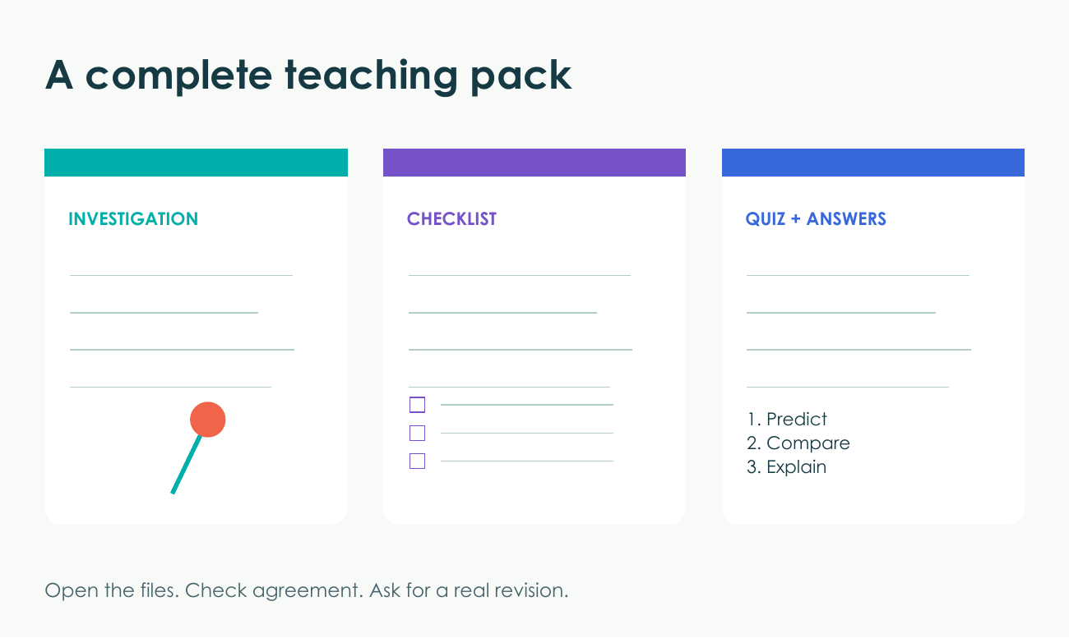
Delegate the teaching pack
PROJECT 04 / DELEGATE
A student investigation, teacher checklist and quiz with answers.
ChatGPT Work, dots, Grok Bot or Muse with file tools
15–18 min / one first version, one check, one revision
Notes:
Project 04 reference, outside the timed main presentation. Participants choose one project, not all five. Companion guide: https://ai-in-action.stemed.ca/projects/04.html
First win: A student investigation, teacher checklist and quiz with answers.
Check: Three actual outputs exist or the account limitation is explicit. Student and teacher versions agree. The quiz answer matches the sources.
Fallback: Use the authored Example_Teaching_Pack.pdf as a comparison. Text sections can still teach the workflow when file creation is unavailable.
Preview is an authored workshop example, not a claimed output from the participant’s account.
Gemini Notebook studio: https://support.google.com/gemininotebook/answer/16206563?hl=en
Audio Overviews: https://support.google.com/gemininotebook/answer/16212820?hl=en
AI Studio Build: https://ai.google.dev/gemini-api/docs/aistudio-build-mode
AI Studio access: https://ai.google.dev/gemini-api/docs/available-regions
Google Antigravity browser: https://antigravity.google/docs/ide/browser
ChatGPT Work: https://learn.chatgpt.com/docs/use-chatgpt
OpenAI dots: https://learn.chatgpt.com/docs/dots
Grok Bot: https://docs.x.ai/grok-bot/overview
Meta Muse: https://about.fb.com/news/2026/09/introducing-muse-personal-ai-agent/
STEM ED: https://stemed.ca
Pendulum reference: https://openstax.org/books/college-physics-2e/pages/16-4-the-simple-pendulum

Slide 25
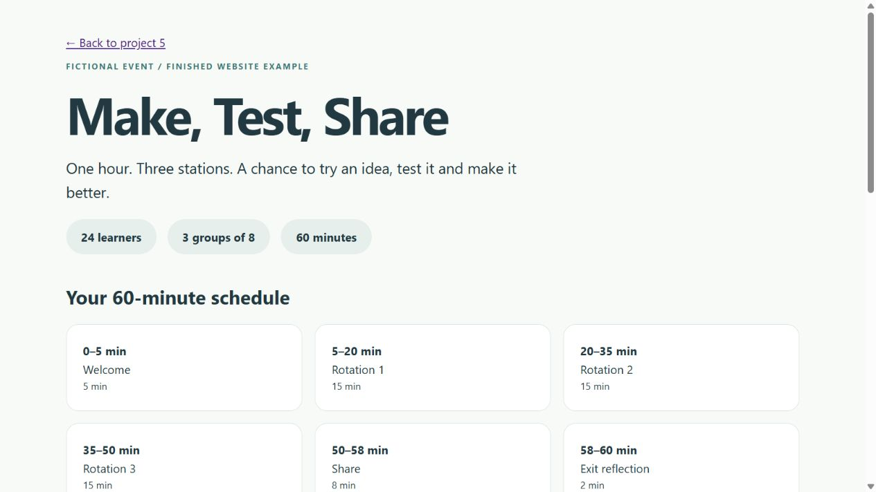
Website to finished assets
PROJECT 05 / PRODUCE
A PowerPoint, PDF, Word document or one-page website.
Work, dots, Grok Bot or Muse with browser and file tools
15–18 min / one first version, one check, one revision
Notes:
Project 05 reference, outside the timed main presentation. Participants choose one project, not all five. Companion guide: https://ai-in-action.stemed.ca/projects/05.html
First win: A PowerPoint, PDF, Word document or one-page website.
Check: An actual file opens in its intended format. Facts match the source. The first schedule totals 60 minutes; the revised one totals 45.
Fallback: Download Maker_Day_Source_Brief.pdf instead of browsing. Use the finished examples to inspect or revise an actual asset. Choose an export format your account supports.
Preview is an authored workshop example, not a claimed output from the participant’s account.
Gemini Notebook studio: https://support.google.com/gemininotebook/answer/16206563?hl=en
Audio Overviews: https://support.google.com/gemininotebook/answer/16212820?hl=en
AI Studio Build: https://ai.google.dev/gemini-api/docs/aistudio-build-mode
AI Studio access: https://ai.google.dev/gemini-api/docs/available-regions
Google Antigravity browser: https://antigravity.google/docs/ide/browser
ChatGPT Work: https://learn.chatgpt.com/docs/use-chatgpt
OpenAI dots: https://learn.chatgpt.com/docs/dots
Grok Bot: https://docs.x.ai/grok-bot/overview
Meta Muse: https://about.fb.com/news/2026/09/introducing-muse-personal-ai-agent/
STEM ED: https://stemed.ca
Pendulum reference: https://openstax.org/books/college-physics-2e/pages/16-4-the-simple-pendulum

Slide 26
A workspace that can finish the job
Sources to media
Gemini Notebook
Prompt to working app
Google AI Studio or Antigravity
Data or finished files
Work, dots, Grok Bot or Muse
Visible computer actions
A workspace with actual browser tools
Use an account you already have. Check its tools first.
Notes:
Reference only. Use the workspace that can actually finish your chosen job. File export, media creation and browser capabilities vary by account. The primary breakout instruction is the project guide and prompt on https://ai-in-action.stemed.ca/
Gemini Notebook studio: https://support.google.com/gemininotebook/answer/16206563?hl=en
Audio Overviews: https://support.google.com/gemininotebook/answer/16212820?hl=en
AI Studio Build: https://ai.google.dev/gemini-api/docs/aistudio-build-mode
AI Studio access: https://ai.google.dev/gemini-api/docs/available-regions
Google Antigravity browser: https://antigravity.google/docs/ide/browser
ChatGPT Work: https://learn.chatgpt.com/docs/use-chatgpt
OpenAI dots: https://learn.chatgpt.com/docs/dots
Grok Bot: https://docs.x.ai/grok-bot/overview
Meta Muse: https://about.fb.com/news/2026/09/introducing-muse-personal-ai-agent/
STEM ED: https://stemed.ca
Pendulum reference: https://openstax.org/books/college-physics-2e/pages/16-4-the-simple-pendulum

Slide 27
Ready examples when you need them
Media
A four-frame storyboard
Survey
An infographic and checked fact sheet
App
A working local Swing Lab
Assistant
An example teaching pack
Website
Finished assets from one source
Notes:
Reference and backup only. The companion hub supplies individual authored example files. A storyboard is a media fallback, not a generated audio/video file. If the tool cannot browse, attach the source PDF. If it cannot export the desired format, choose one it supports or revise the supplied example. Examples: https://ai-in-action.stemed.ca/resources.html#examples

